Slide 1

PBEL Virtual Internship
Project Title: TanStack Shadcn Weather App
Submitted By:
Name: Sarthak Gupta
College: United Institute of Management
Submitted To:
Name: Mr. Deepanshu Kumar

Slide 2
Declaration
I hereby declare that this project report titled “TanStack Shadcn Weather App” is a result of my own work carried out during the IBM PBEL Virtual Internship. The project is original, and no part of it has been copied or submitted elsewhere for any other course or internship.
Acknowledgement
I would like to express my heartfelt gratitude to my Project guide, Mr. Deepanshu Kumar for their valuable support, guidance, and encouragement throughout the project. Their constructive feedback and constant motivation helped me complete this internship successfully.
I also extend my sincere thanks to the IBM PBEL team for offering this incredible opportunity to gain practical experience. My appreciation also goes to my college, KCC Institute of Technology and Management, and my peers who supported me during the course of this internship.

Slide 3
Table of Contents
Introduction
The project titled “TanStack Shadcn Weather App” was developed as part of the IBM PBEL Virtual Internship to gain hands-on experience in full-stack web development. The goal of the project is to combines a user-friendly interface with powerful features like detailed forecasts, city search, favorites, and interactive charts, all backed by a robust technology stack. TanStack Query ensures efficient API interactions, TypeScript guarantees reliability, React powers the dynamic frontend, shadcn and TailwindCSS deliver a polished UI, and Recharts provides insightful visualizations. This combination makes the app both functional and visually appealing, suitable for users seeking a modern weather tracking solution.

Slide 4
Key Features
Beautiful UI: Toggle between light and dark modes for enhanced usability and accessibility.
Detailed Forecasts: 12hour weather data with temperature and “feels like” metrics.
Favorites System: Save favorite cities for quick access to weather information.
Search Functionality: Search weather for any city worldwide with ease.
Interactive Charts: Visualize temperature trends using Recharts for intuitive insights.

Slide 5
Technology & Architecture
React.js: Builds the dynamic, component-based user interface.
TypeScript: Ensures type safety for robust development.
TanStack Query: Manages API fetching, caching, and refetching.
shadcn & TailwindCSS: Provides scalable, responsive styling with light/dark mode support.
Recharts: Renders interactive temperature charts.
Vite: Enables a fast and optimized development environment.
Git & GitHub: Facilitates version control and project hosting.

Slide 6
Challenges & Solutions
Problem: API Data Fetching Efficiency
Challenge: Slow or redundant API calls for weather data.
Solution: Implemented TanStack Query for caching and automatic refetching on focus or intervals.
Problem: Responsive UI Design
Challenge: UI layout issues on smaller screens.
Solution: Used TailwindCSS utility classes for responsive grids and spacing.
Problem: Chart Data Integration
Challenge: Rendering dynamic temperature data in charts.
Solution: Structured API data for Recharts with interactive features like tooltips.
Problem: State Management for Favorites
Challenge: Managing favorite cities across components.
Solution: Utilized local storage and TanStack Query for efficient state persistence.

Slide 7
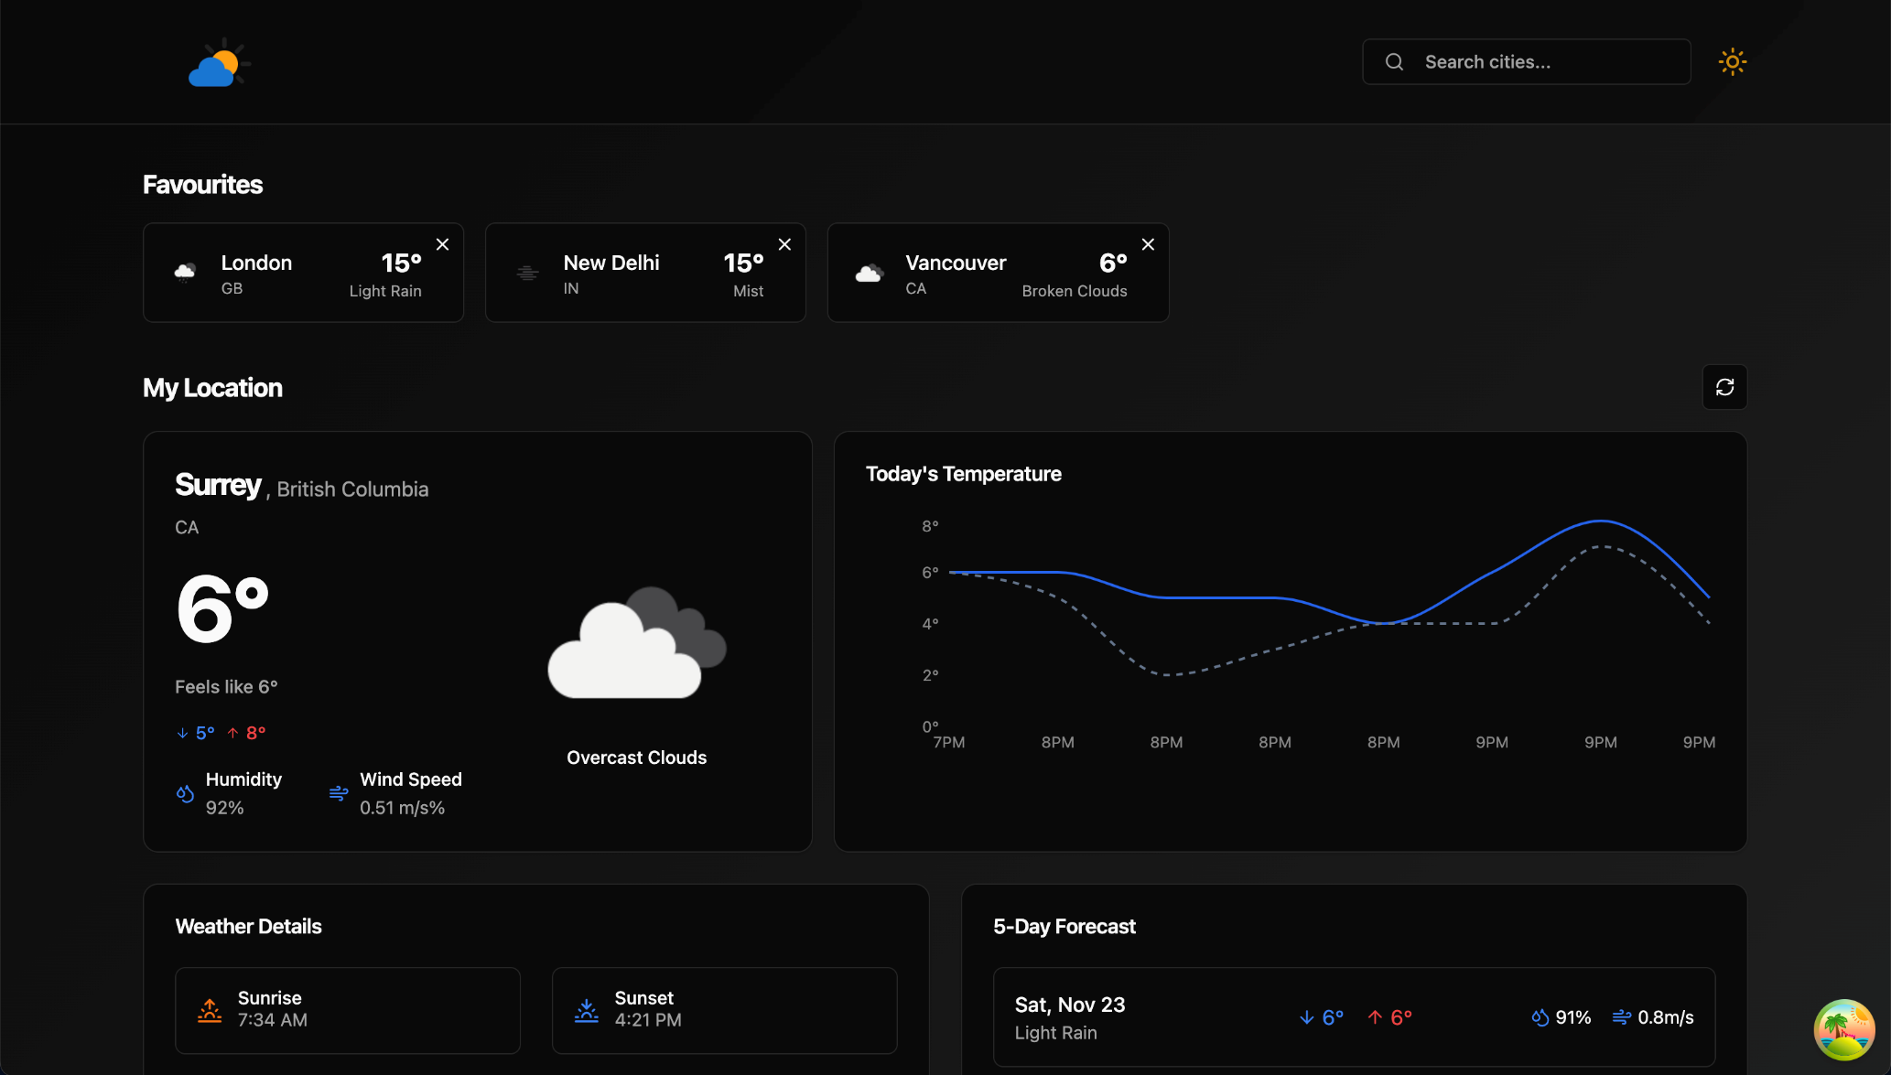
Output Screenshot
HOMEPAGE

Slide 8
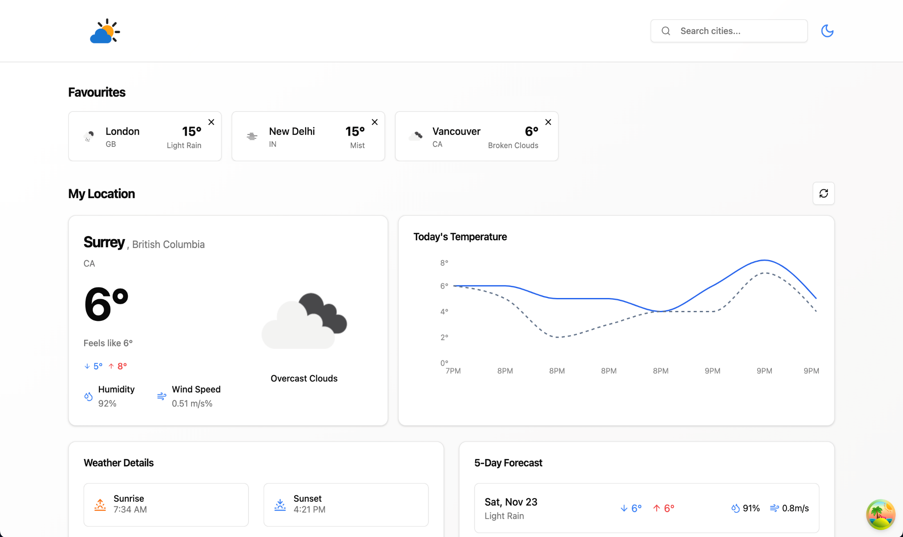
THEME:LIGHT MODE

Slide 9
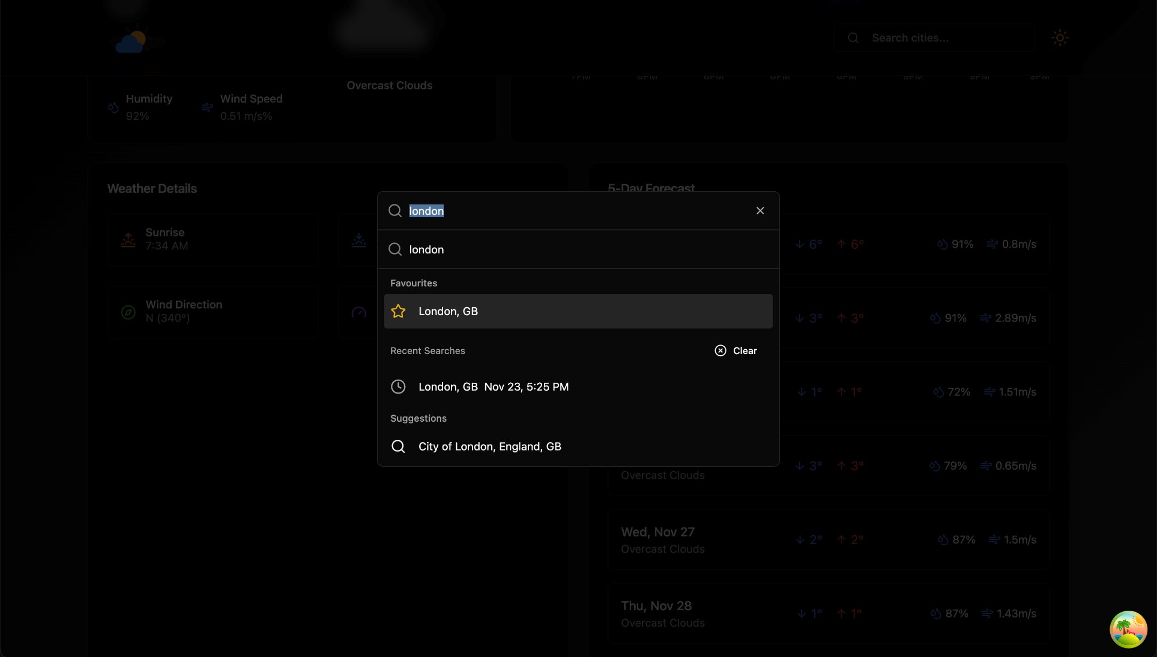
SEARCH BOX CARD

Slide 10
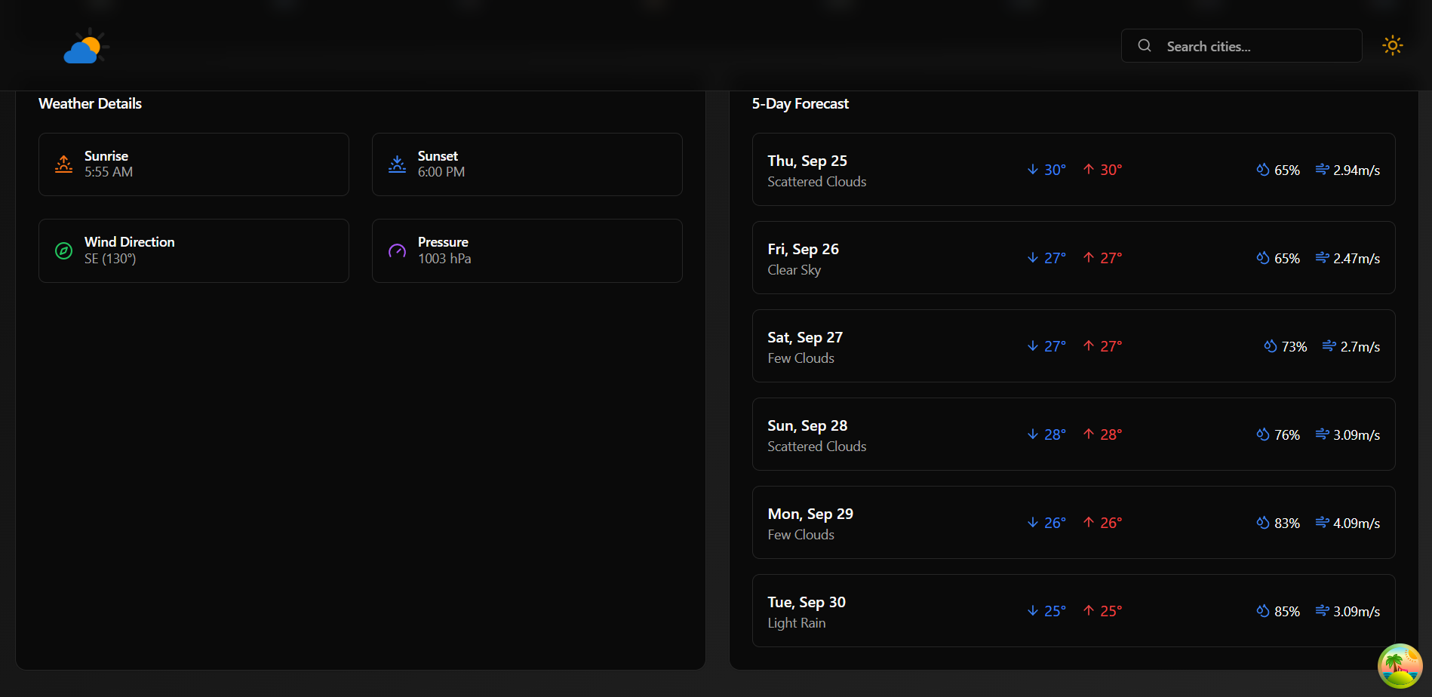
WEATHER DETAILS
5-DAYS FORECAST

Slide 11
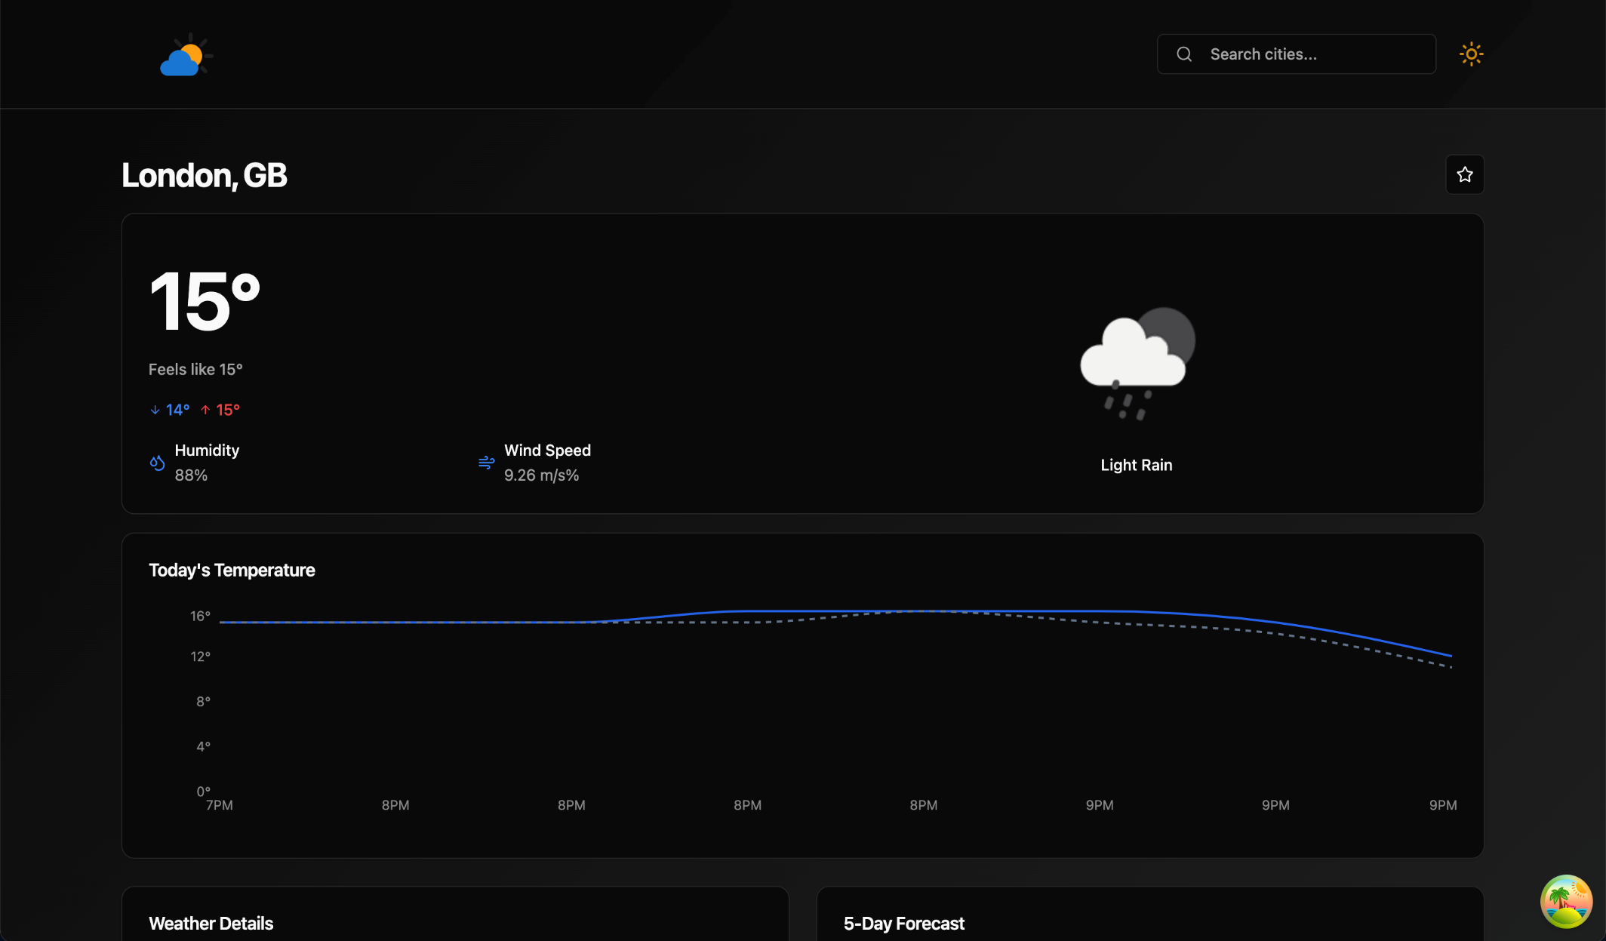
TEMPERATURE CHART

